Slide 1
Call for Proposals (3 of 4)
World Risk Poll 2021:
Digital World
Perceptions of risk from AI and misuse of personal data
lrfworldriskpoll.com
@LR_Foundation // #WorldRiskPoll

Slide 2
Lloyd’s Register Foundation
An independent global charity with a mission to engineer a safer world
Unique structure and sole shareholder of Lloyd’s Register Group
Work to reduce risk and enhance the safety of critical infrastructure
Award grants and support work which helps us deliver our charitable mission
Aim to improve safety through interventions that are driven by evidence of what works
We focus on the biggest safety challenges: Safety at sea, safety of digital systems, safety for a sustainable future, safety of food, skills for safety, safety of physical infrastructure, public understanding of risk.

Slide 3
The Lloyd’s Register Foundation World Risk Poll
121 countries, 125000 interviews
Assessing perception and experience of risk
In places where little or no official data on safety exists
Disaster resilience, violence & harassment at work, data privacy & artificial intelligence

Slide 4
World Risk Poll 2019 Projects

Slide 5
World Risk Poll 2021 - Call for Proposals
Foundation strategic aim to maximise the impact of the Poll data
Second in a series of 4 calls linked to each 2021 World Risk Poll focus area
Perceptions and experiences of risk in the Covid Age (call announcement)
Global resilience - perceptions and experiences of disaster preparedness (call announcement)
Perceptions of harm from AI and misuse of personal data (call announcement)
Violence and harassment at work (early Jan)
Grant funding available for impactful research and interventions that utilise the Poll data and aim to improve global safety
Budget: We expect that the typical budgets for the proposed projects may range between £250,000 and £750,000 but we are also open to receiving applications for projects outside this range, as appropriate to the type and scale of the intervention proposed.
Deadline of 28/02/2023 for applications from all four calls
Prospective applicants must first register interest on Flexigrant

Slide 6
Demonstrate a tangible link with the World Risk Poll dataset
e.g. addressing an issue which affects a specific community that has been identified by the Poll
e.g. embedding the Poll data in the proposed work
Possible outcomes for projects which practically apply the Poll findings through the development of new interventions or by strengthening existing ones. For instance, a project may focus on better design and construction of technologies to remove bias, the development and implementation of appropriate regulation, or the engagement of vulnerable communities to build trust in these developments.
Similarly, research projects may aim to address data gaps or support hypotheses through secondary analysis of the Poll data and/or to use alongside other relevant data. An important output could be the provision of evidence, disseminated to stakeholders, which motivates action. For example, research projects which find robust evidence for how and why particular demographics are most impacted by safety challenges, that effectively communicate findings to relevant bodies, and consequently influence improvements to public risk information.

Slide 7
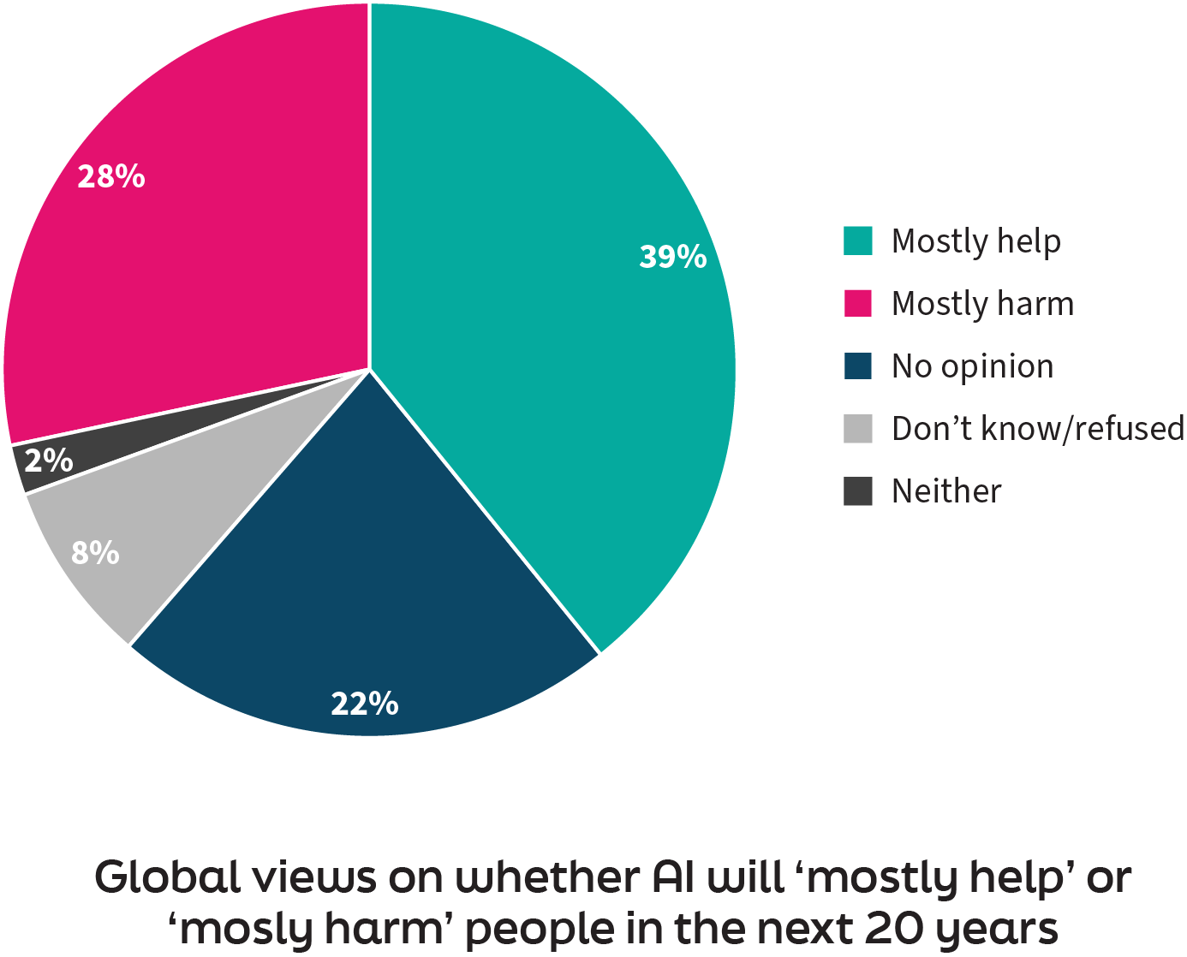
2 people in 5 globally view AI positively…

Slide 8
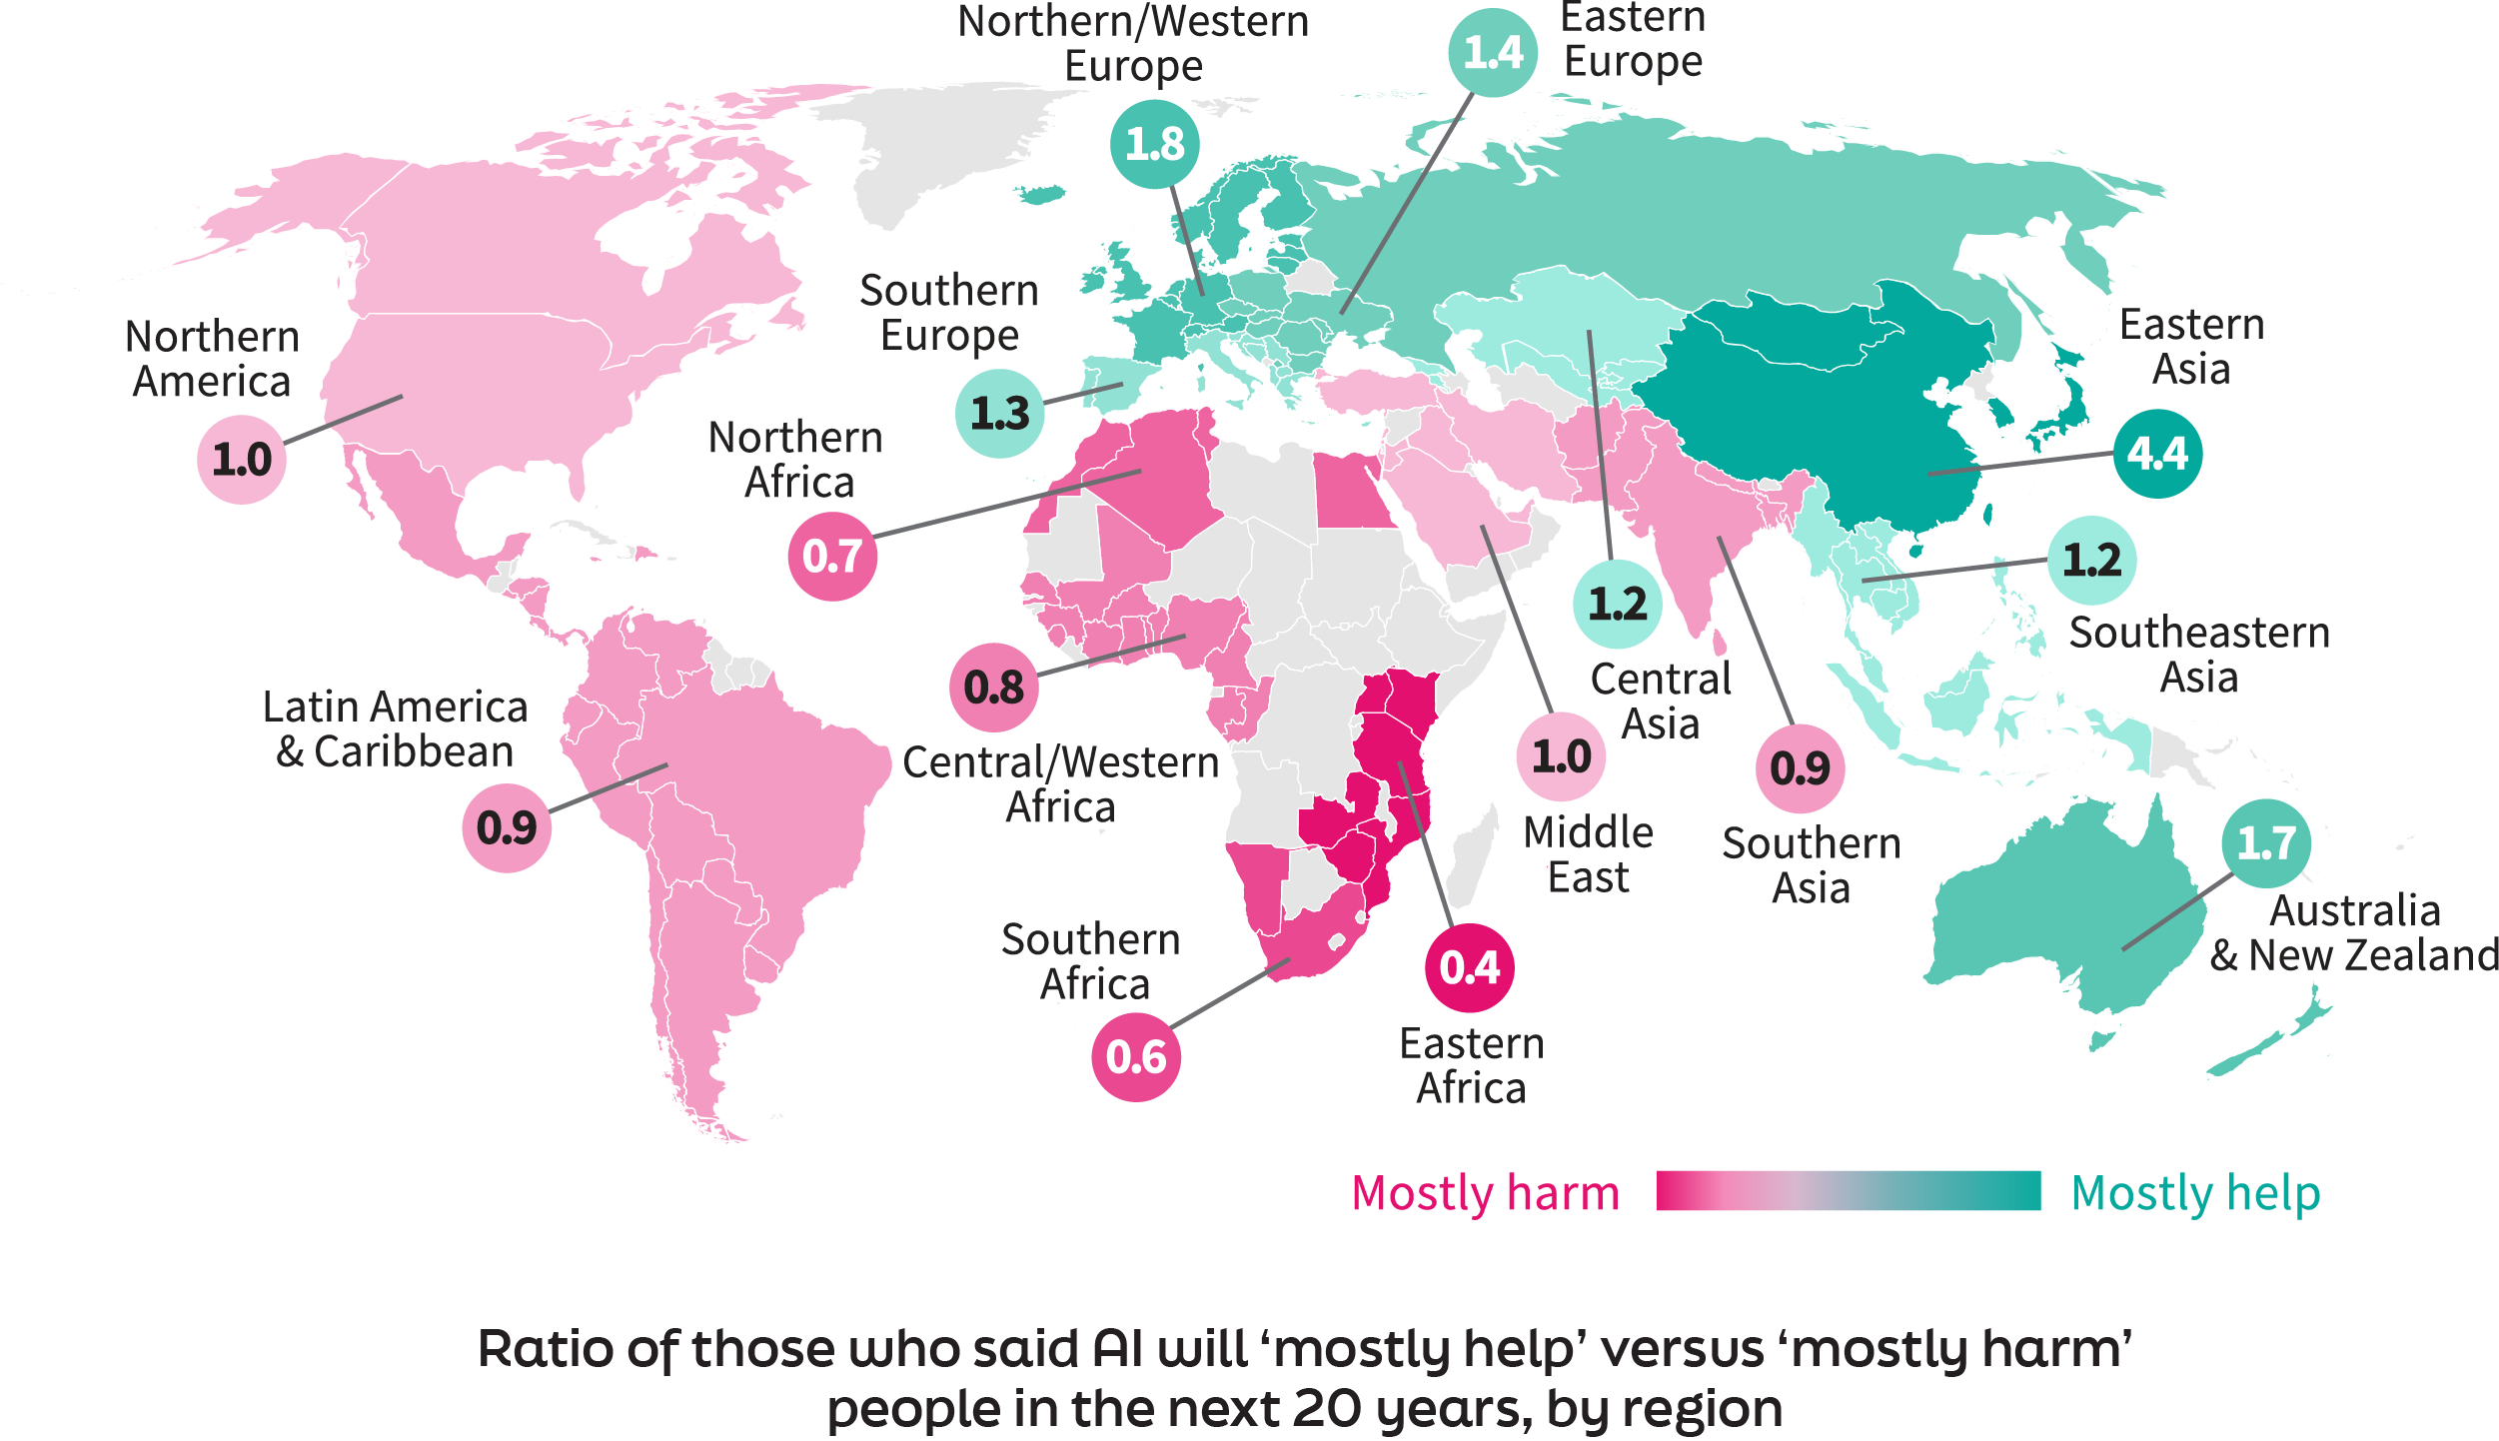
…but there is significant regional variation

Slide 9
A majority of internet users are concerned about misuse of their data

Slide 10
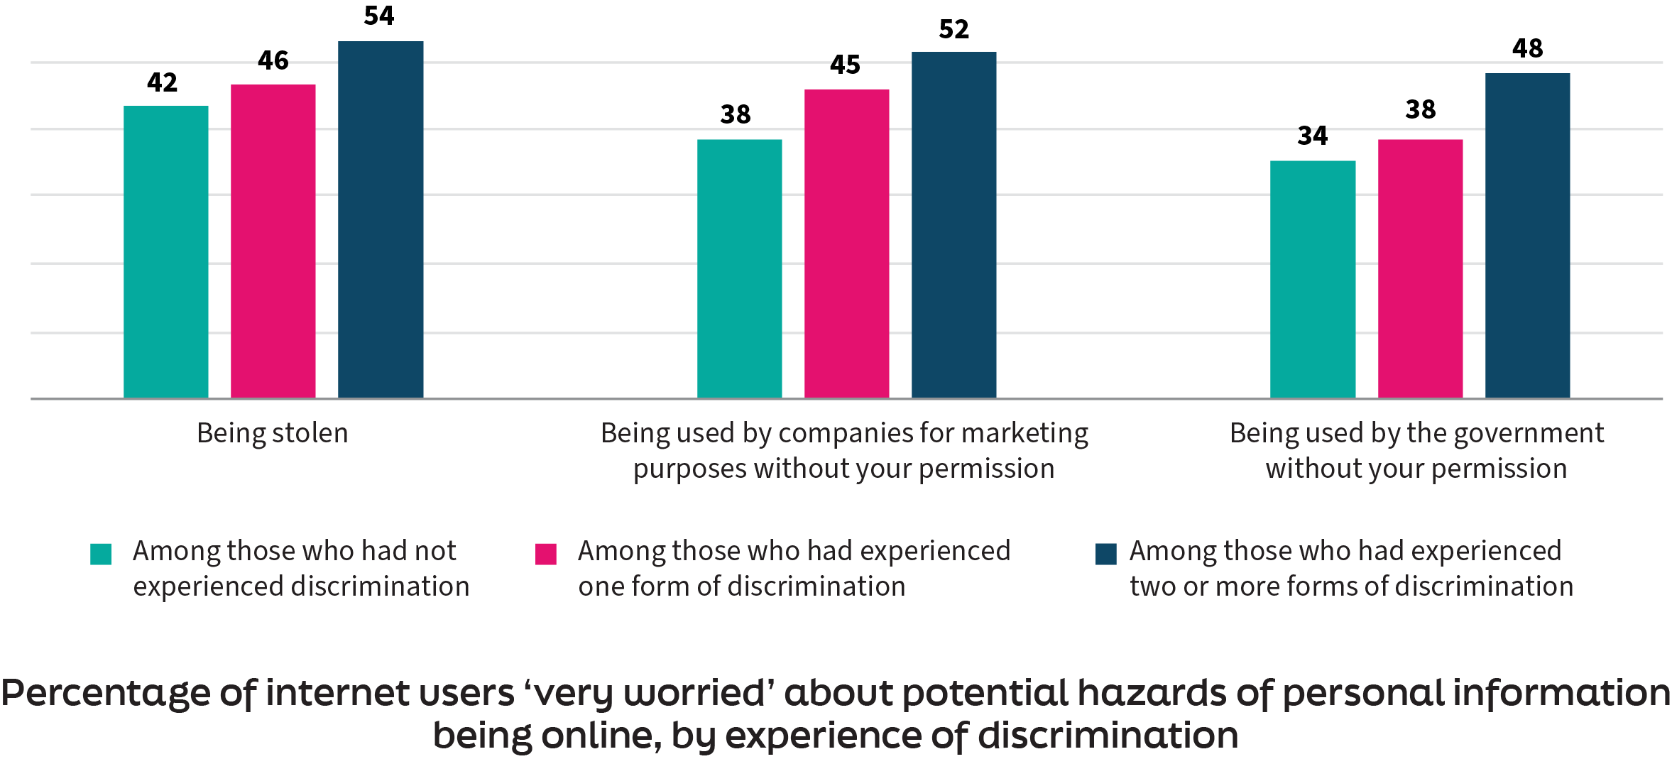
Experience of discrimination increases concern about data misuse

Slide 11
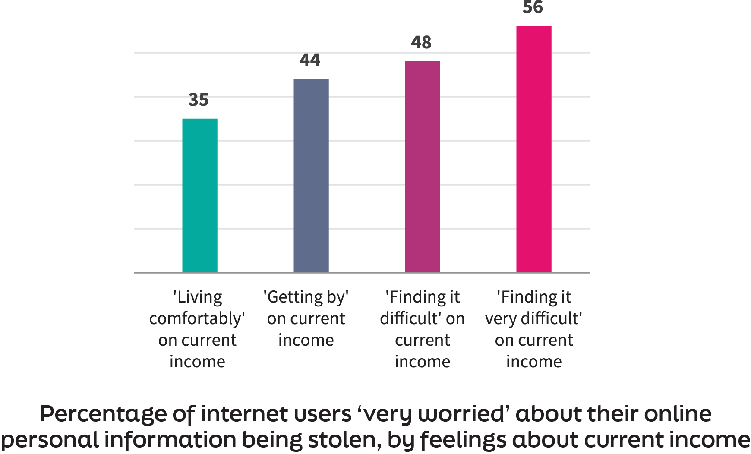
Personal income is a major driver for worry about personal data theft

Slide 12
Questions

Slide 13
lrfworldriskpoll.com
Explore the poll – stories and visual snapshots
Download the full dataset
Apply for funding to turn the World Risk Poll into action
Queries to worldriskpoll@lrfoundation.org.uk
lrfworldriskpoll.com
@LR_Foundation // #WorldRiskPoll

